Slide 1
internet routing
Applying Approximate Distance Oracles to
Matteo Pariset
Supervisor
Cristina Basescu
Advisor
Prof. Bryan Ford

Slide 2
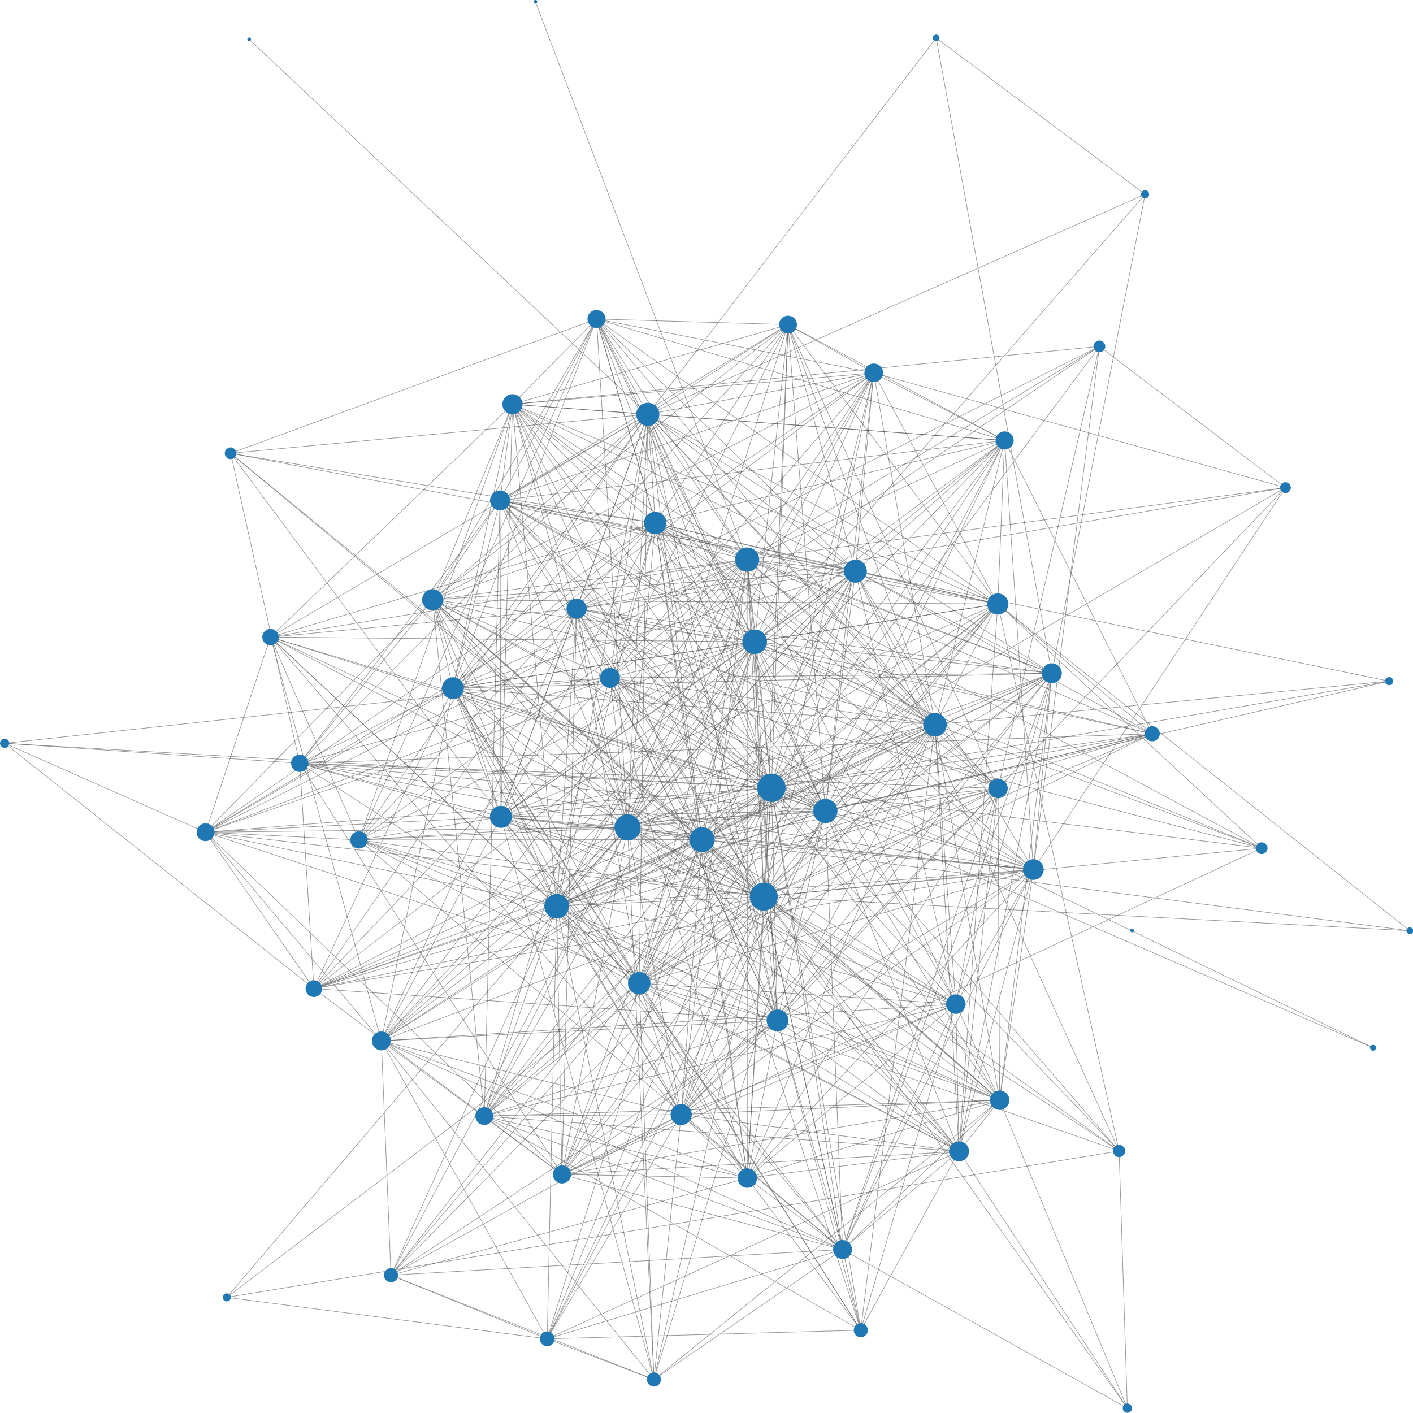
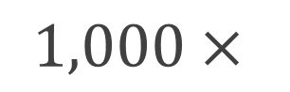
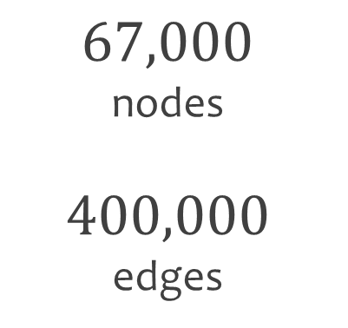
Getting to know The AS graph
$$67,000$$
nodes
$$400,000$$
edges
$$1,000×$$

Slide 3
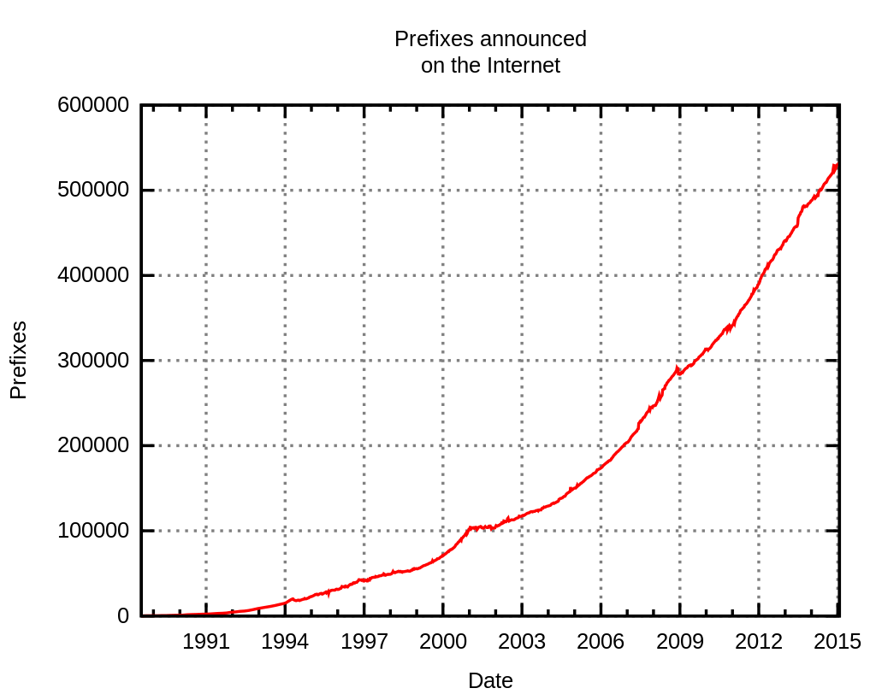
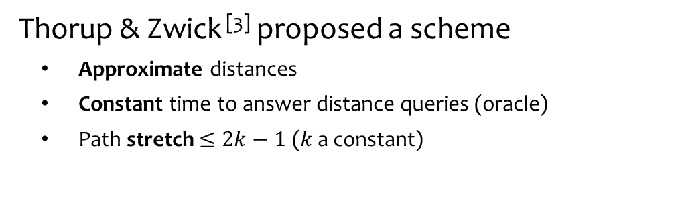
the PROBLEM
BGP has scalability issues^{[2]}:
Exponential routing table growth
Convergence problems
Worst-case exponential communication cost ^{[5]}
Source Wikipedia
Thorup & Zwick ^{[3]} proposed a scheme
Approximate distances
Constant time to answer distance queries (oracle)
Path stretch $≤2k−1$ ($k$ a constant)

Slide 4
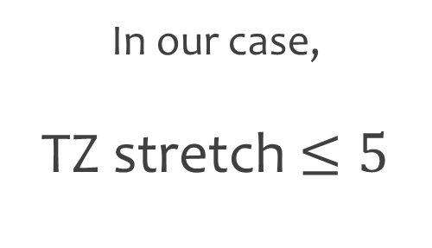
Getting to know Stretch
In our case,
TZ stretch $≤5$

Slide 5
the PROJECT
Adapt TZ scheme to
(dynamic) Internet routing
Simulate its behavior on
the real AS graph:
Measure real stretch
Study effects of link failures
Measure communication cost

Slide 6
TZ for Internet routing

Slide 7
Getting to know Landmarks
In TZ, landmarks used to approximate paths
Nodes only keep paths to them*
Shortest path
TZ approximation
*almost

Slide 8
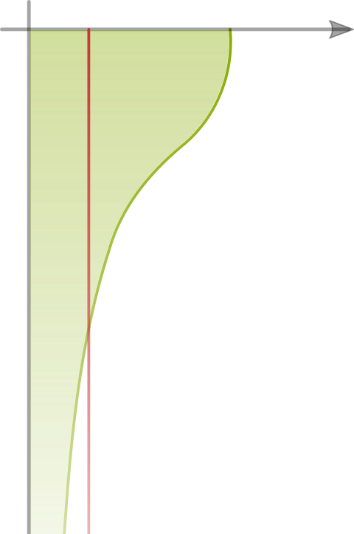



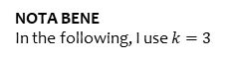
TZ for routing Landmarks selection
Popularity Selection
Probability distribution
Probability of selection
TOP 200 AS
with most customers are more likely to become landmarks
Use the natural AS hierarchy
to produce better paths
AS ranking by # of customers
Our selection probability
ASes with many customers are
more likely to become landmarks
Original selection probability
Traffic in the Internet
The AS hierarchy
NOTA BENE
In the following, I use $k=3$

Slide 9
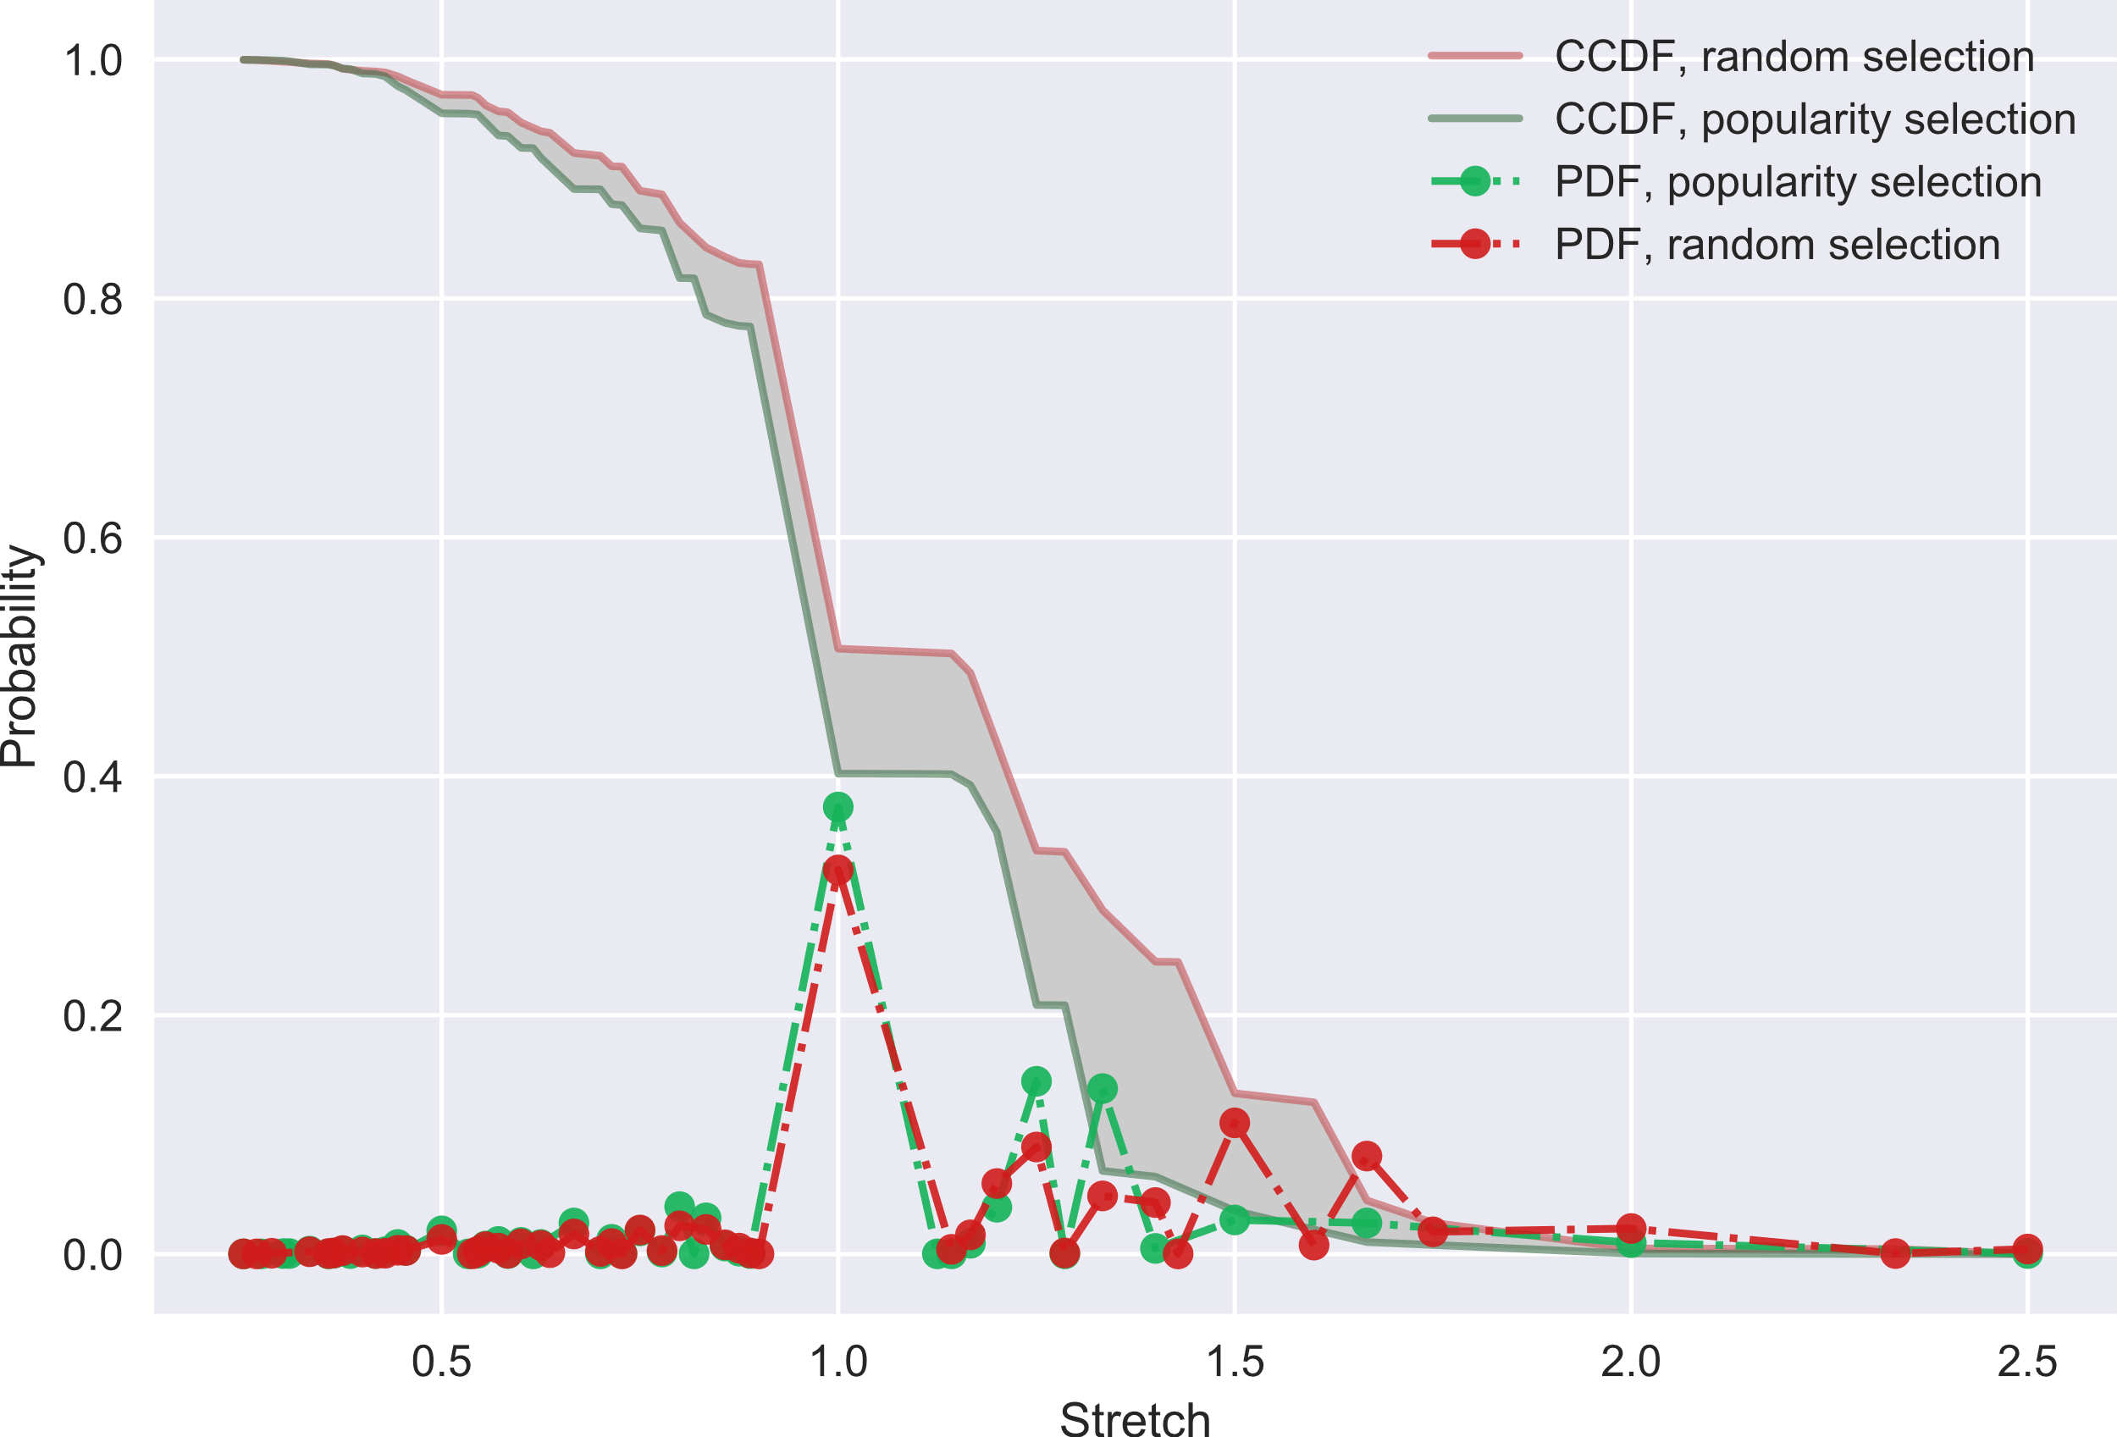

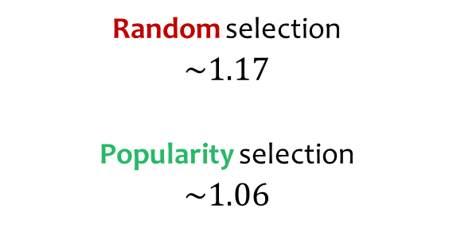
the RESULTS Measured average stretch
Landmark selection impact
on stretch
TZ max stretch
$$5$$
Random selection
$\sim 1.17$
Popularity selection
$$\sim 1.06$$
Need more information on
the quality of paths
NOTA BENE
In the following, I use $k=3$

Slide 10
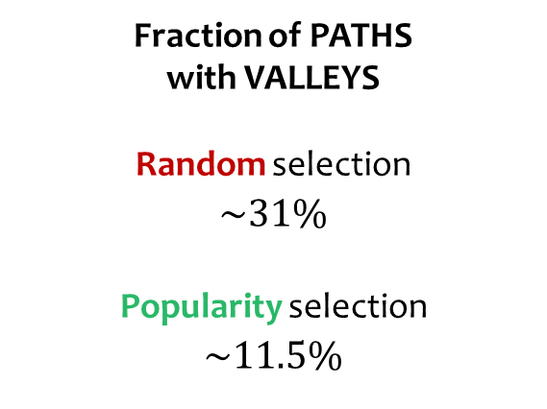
the RESULTS Path quality
Fraction of PATHS
with VALLEYS
Random selection
$$\sim 31\%$$
Popularity selection
$$\sim 11.5\%$$
We count the paths with valleys
Link types:
Example of path
with valley
Provider-Customer
link
Peering
link
Too many paths still contain valleys
NOTA BENE
In the following, I use $k=3$

Slide 11
TZ for routing Gao-Rexford Rules^{[6]}
Advertise customer routes to peers
TZ has no notion
of link types
Apply GR route filtering rules
to compute TZ structures
(some care required)
Do NOT advertise provider routes to providers
Do NOT advertise provider routes to peers
NOTA BENE
In the following, I use $k=3$

Slide 12
TZ for routing Link failure
Cannot recompute all TZ structures
after link failure
Nodes can ask neighbors for
missing information
(witnesses and bunch)
NOTA BENE
In the following, I use $k=3$

Slide 13

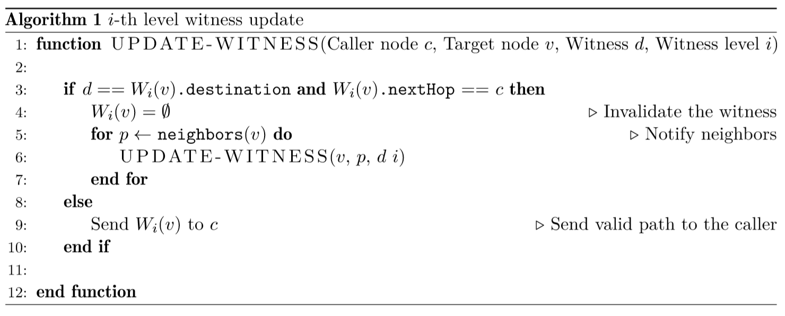


TZ for routing Link failure: Update process
B
A
B
A
C
B
= Invalidation message
A
= Valid alternative route
C
* With some care in executing line 9
NOTA BENE
In the following, I use $k=3$

Slide 14
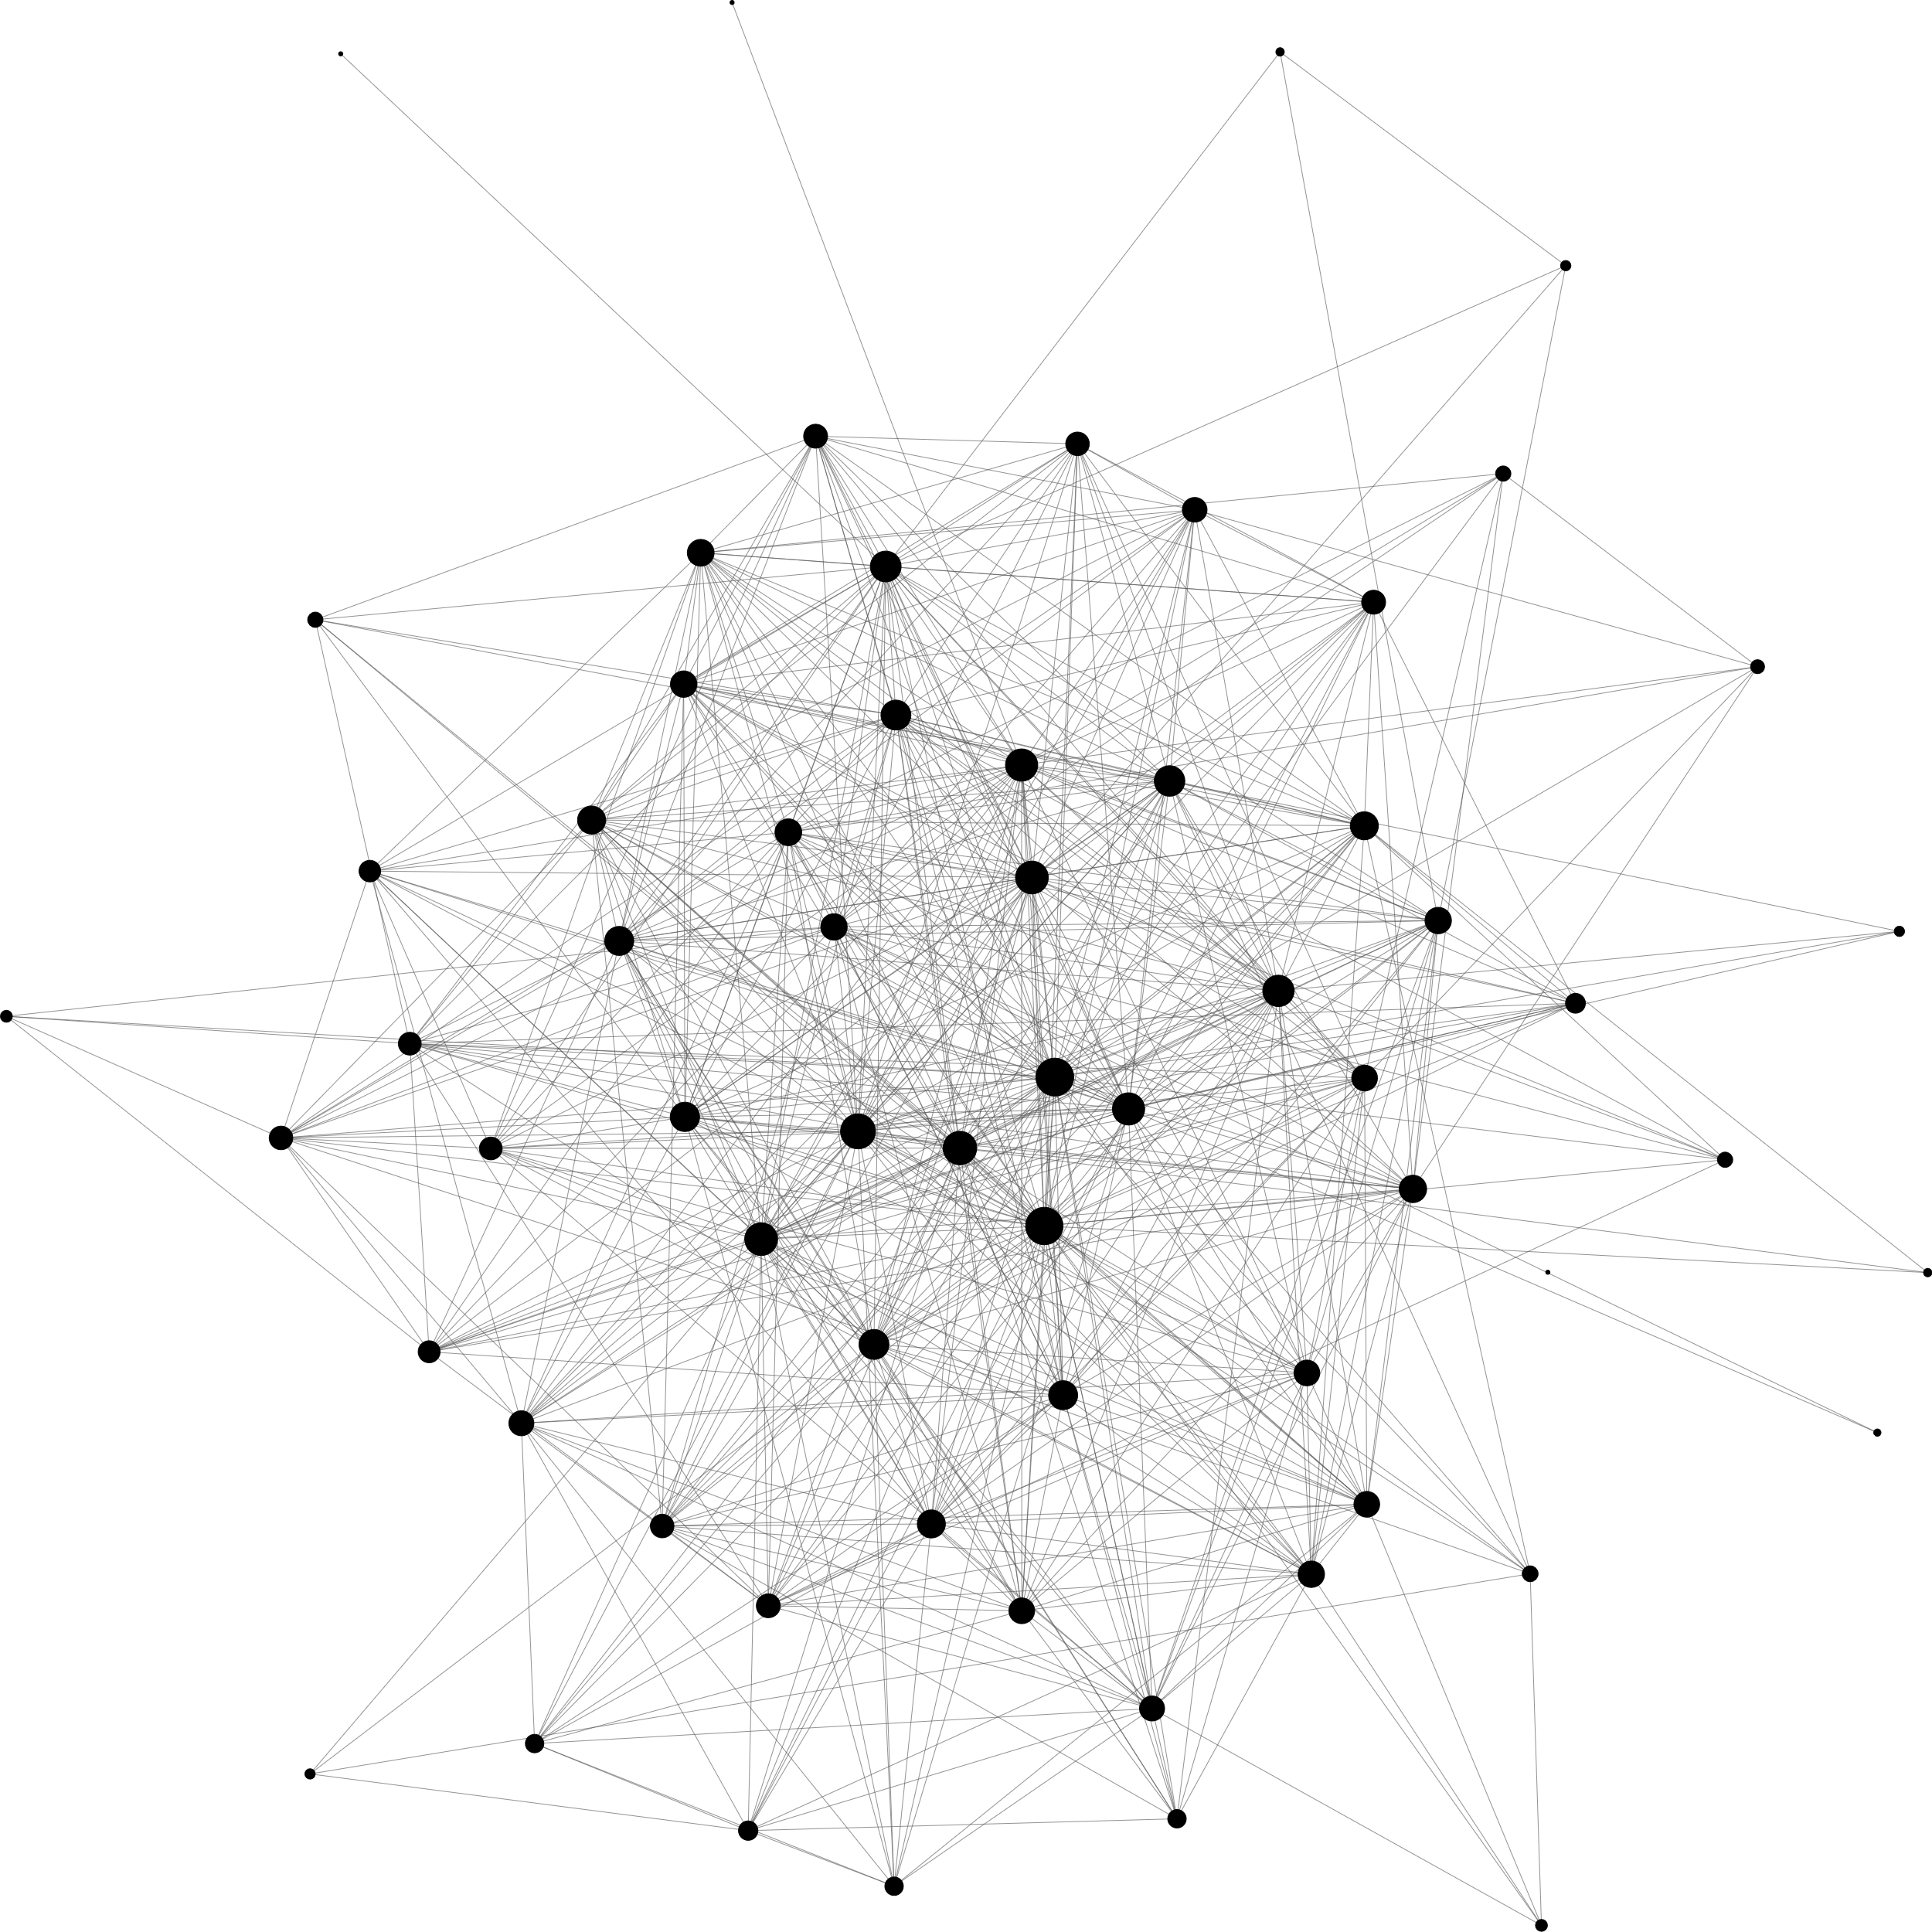
Trade-off Which paths to restore?
How many routes to landmarks should be restored?
Number of nodes reached by
invalidation messages
VS
Number of paths restored
We accept to loose some* destinations
(some TZ structures deterioration)
* well chosen!

Slide 15
simulations
Scenario 1
Scenario 2
Real AS graph
Random edge deletions
Real AS graph
Real link failures

Slide 16
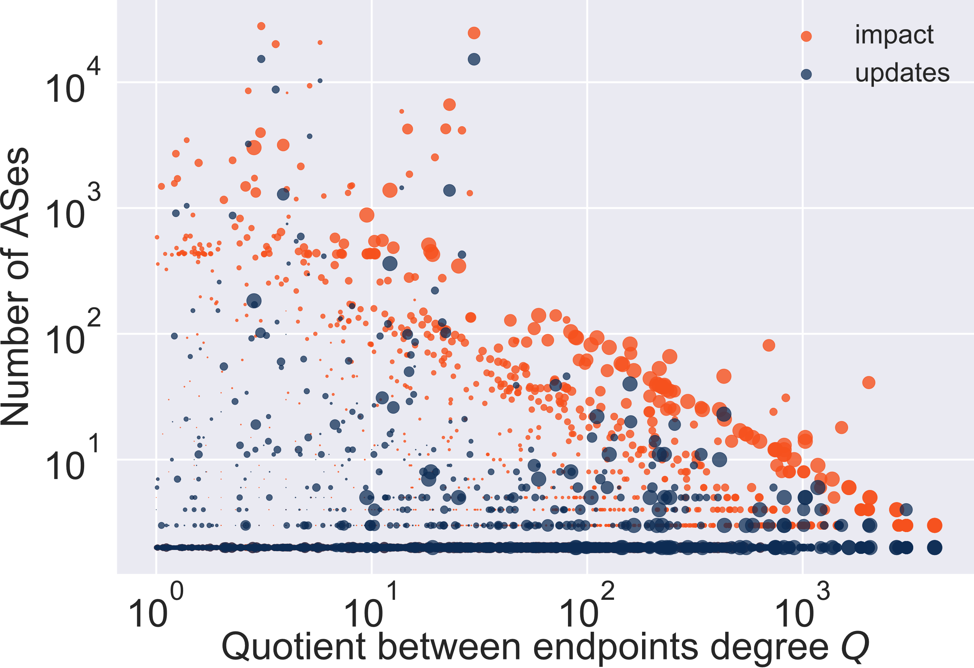
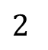
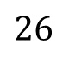
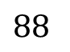
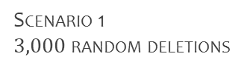
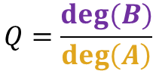
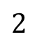
the GOOD side Simulation: Impact & Updates
Random link deletions
Scenario 1
$3,000$ random deletions
Study global effects of link failures
Receive
Invalidation
messages
Modify
TZ structures
Average
$$88$$
$$26$$
Median
$$2$$
$$2$$
$$Q=\frac{deg⁡(B)}{\deg\left(A\right)}$$
A
B
NOTA BENE
In the following, I use $k=3$

Slide 17
the BAD side TZ structures deterioration
AFTER
Scenario 1
$3,000$ random deletions
Study local effects of TZ deterioration
BEFORE
BEFORE
AFTER
Increased use of
top-level landmarks
NOTA BENE
In the following, I use $k=3$

Slide 18
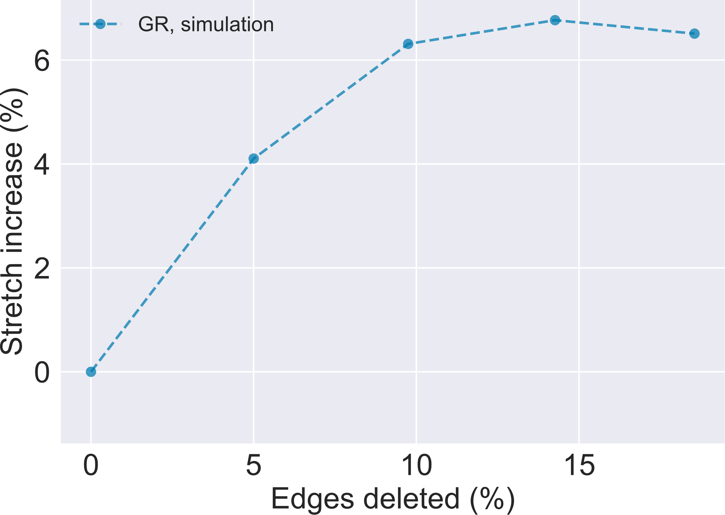
the BAD side Stretch deterioration
Scenario 1
random deletions
Delete multiple edges
Run BGP and TZ in parallel
Periodically measure stretch
Full path restoration
Stretch worsens after
multiple edge deletions
NOTA BENE
In the following, I use $k=3$

Slide 19
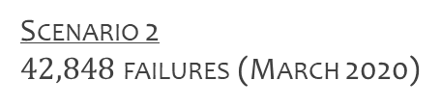
TZ for routing Real link failures
Internet evolution could be different
from random link failures
(in our simulations so far)
Scenario 2
$42,848$ failures (March 2020)
Replay real link failures happened
in AS graph (March and April 2020)
NOTA BENE
In the following, I use $k=3$

Slide 20
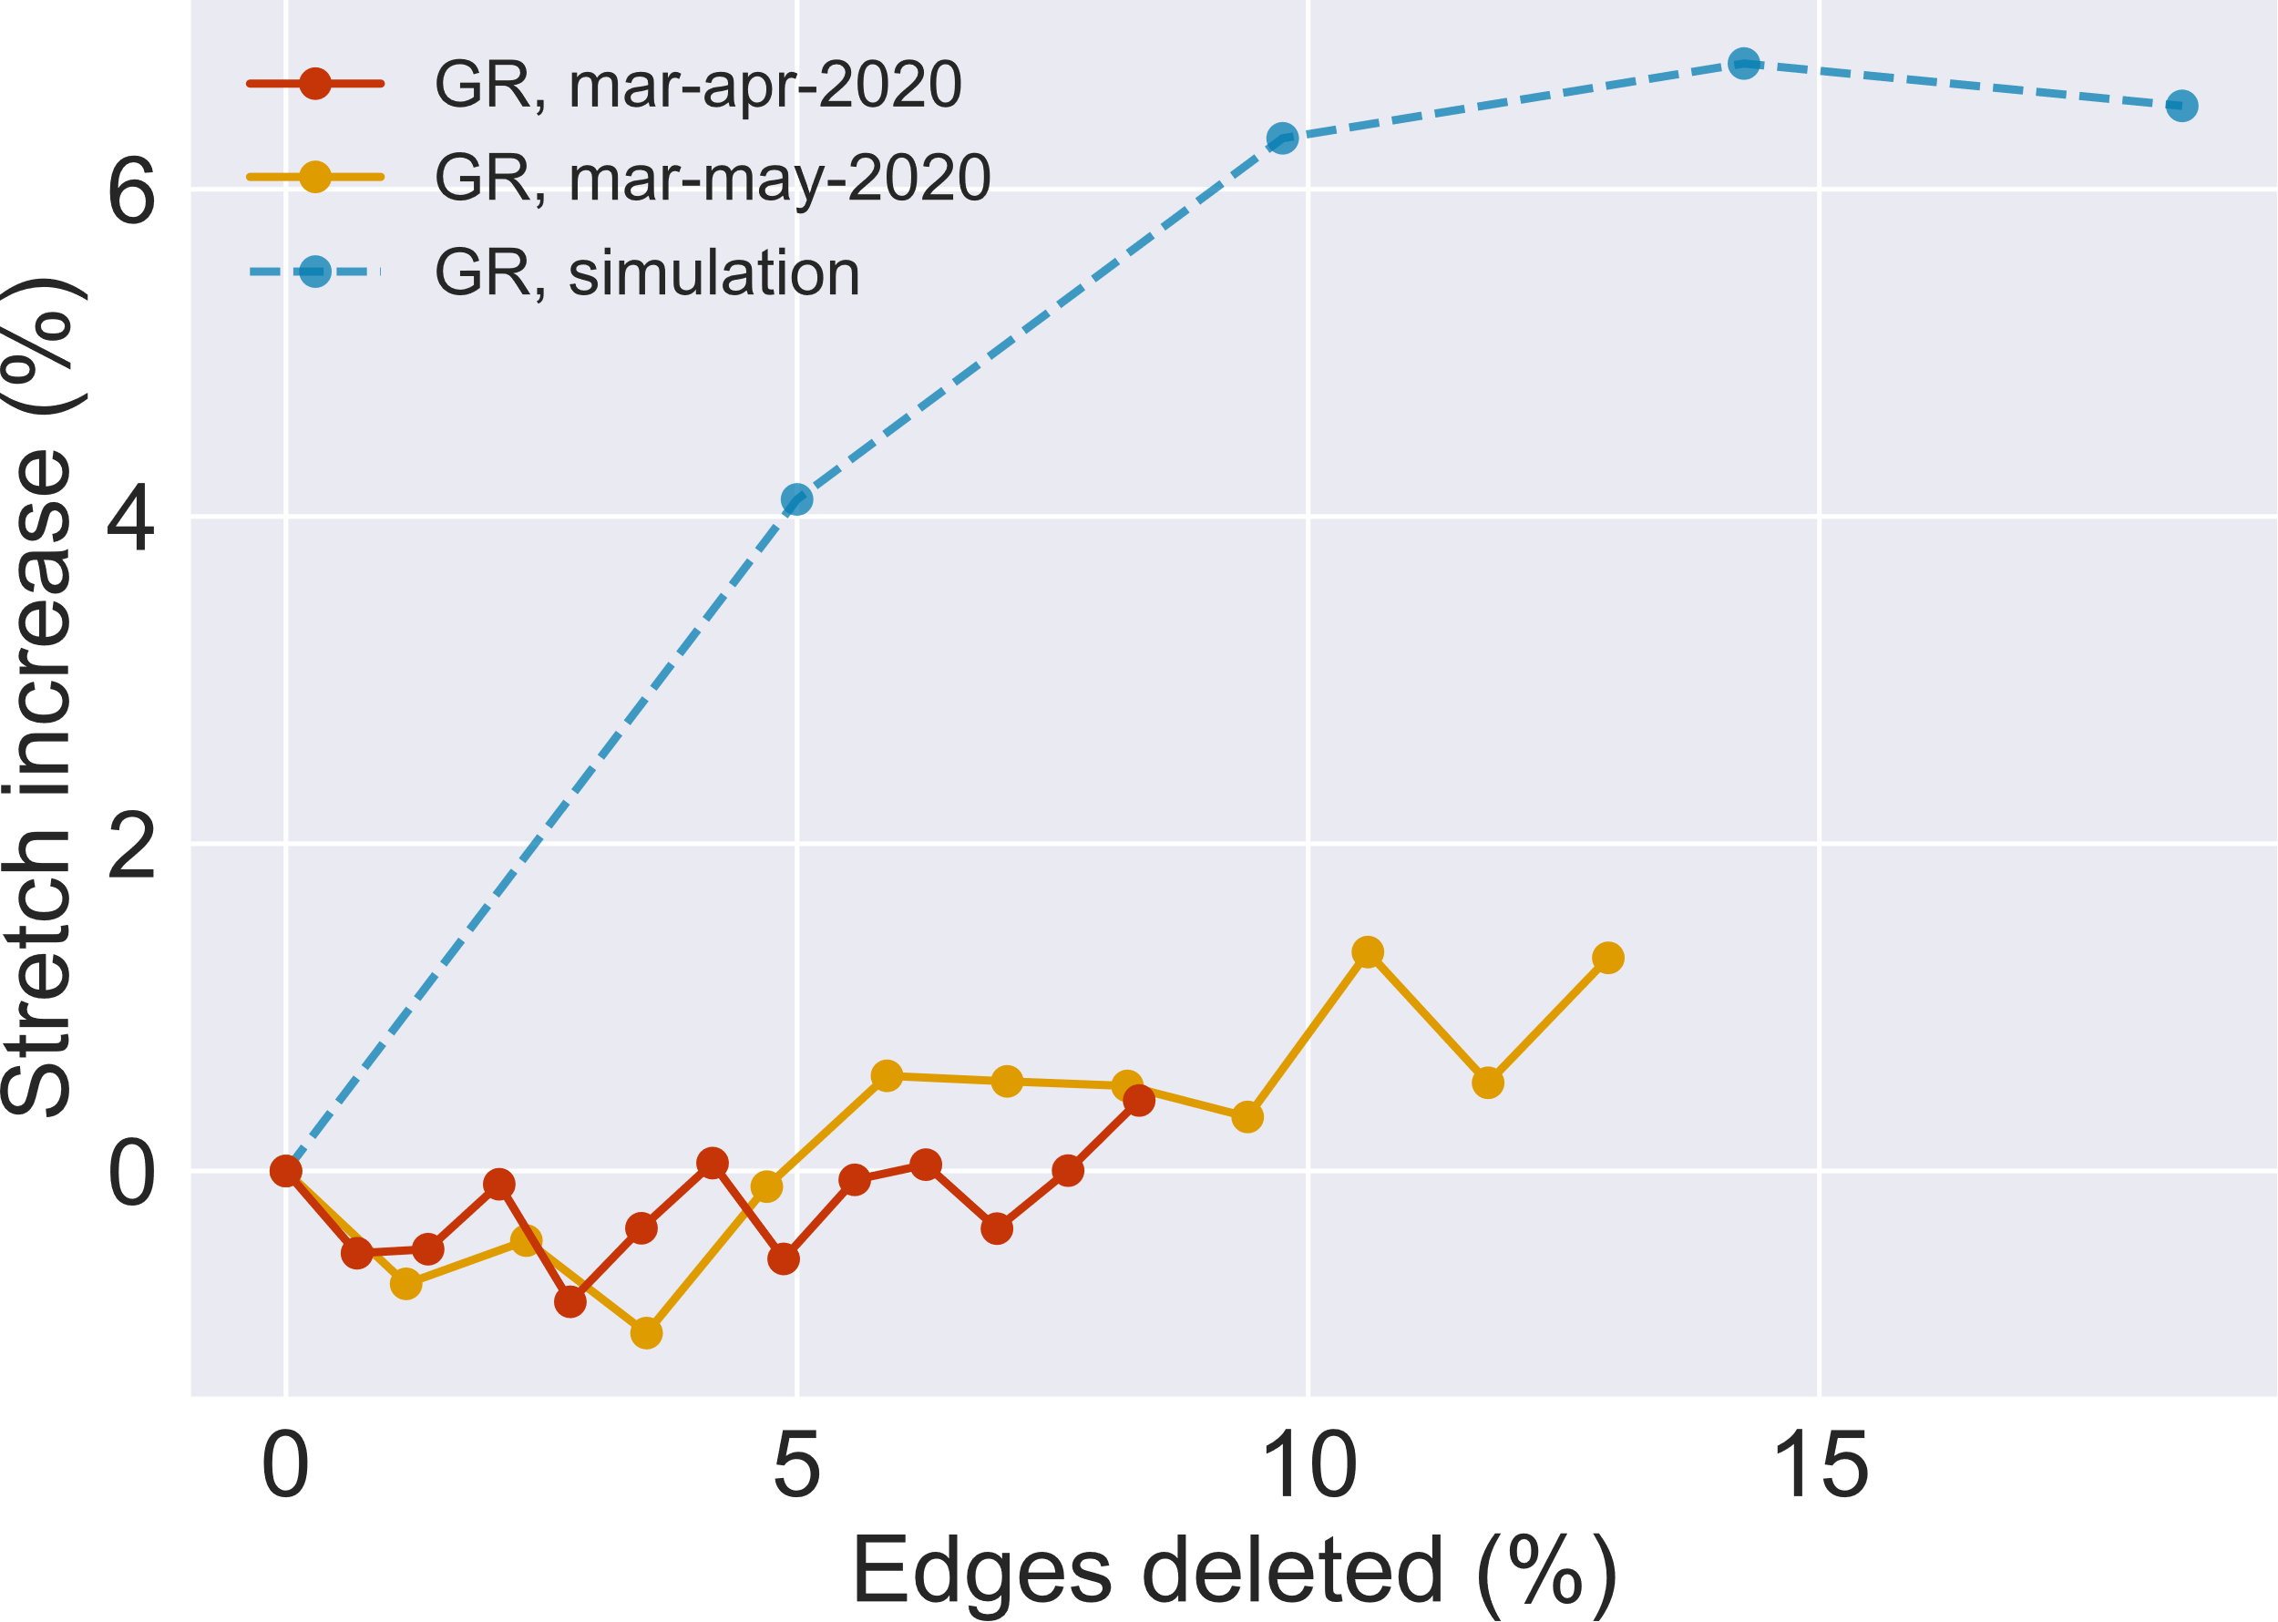
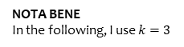
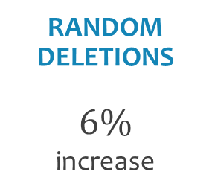
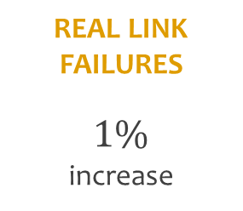
the RESULTS Stretch deterioration
Comparison of stretch deterioration
Stretch deterioration is slower
with real link failures (scenario 2)
than
with random deletions (scenario 1)
After same amount (10%)
of link failures:
RANDOM DELETIONS
$$6\%$$
increase
REAL LINK
FAILURES
$$1\%$$
increase
NOTA BENE
In the following, I use $k=3$

Slide 21
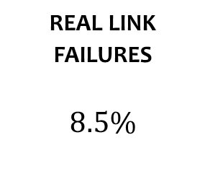
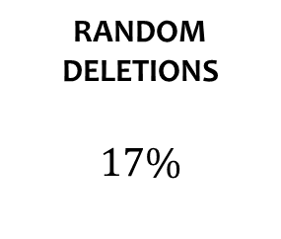
TZ for routing Real link failures
Edges connecting tier-1 ISPs
fail less often
Why is stretch deterioration slower
when replaying real link failures?
Failed links incident
to 64 biggest^{[4]} ASes:
Data show that failures are
not randomly distributed
REAL LINK
FAILURES
$$8.5\%$$
RANDOM DELETIONS
$$17\%$$
NOTA BENE
In the following, I use $k=3$

Slide 22
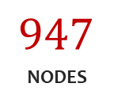
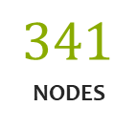
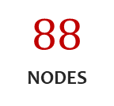
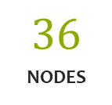
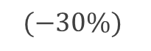
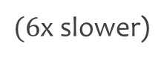
the RESULTS Real evolution: Summary
Real link failures vs. Random edge deletions:
Average
Average
$$36$$
NODES
vs.
$$88$$
NODES
Fewer nodes reached by invalidation messages
Smaller hop-distance traveled by invalidation messages
Slower deterioration of stretch
Standard
deviation
Standard deviation
$$(−30\%)$$
$$341$$
NODES
$$947$$
NODES
vs.
$(6$x slower)
NOTA BENE
In the following, I use $k=3$

Slide 23
CONCLUSIONS
Our findings seem to suggest that:
TZ can be optimized for Internet-like graphs
TZ can efficiently support dynamic topologies
The communication cost of the typical failure in the AS graph is lower than the average random one

Slide 24
VALIDITY
We mostly refer to AS graph
data for March 2020
Can these results be generalized?
We have inspected its evolution
in the last 5 years
Many of AS graph properties did not change
(e.g. scale-free nature)

Slide 25
QUESTIONS?

Slide 26
REFERENCES
[1] A. Broido, E. Nemeth, and kc claﬀy. Internet expansion, reﬁnement, and churn. European Transactions on Telecommunications, 13(1):33–51, 2002.
[2] D. Krioukov, kc claffy, K. Fall and A. Brady. On Compact Routing for the Internet: https://arxiv.org /abs/0708.2309
[3] Mikkel Thorup and Uri Zwick. 2001. Compact routing schemes. In Proceedings of the thirteenth annual ACM symposium on Parallel algorithms and architectures (SPAA ’01). Association for Computing Machinery, New York, NY, USA, 1–10. DOI:https://doi.org/10.1145/378580.378581
[4] https://asrank.caida.org
[5] C. Labovitz, A. Ahuja, A. Bose, and F. Jahanian. Delayed Internet routing convergence. Transactions on Networking, 9(3), 2001
[6] Lixin Gao and J. Rexford, "Stable Internet routing without global coordination," in IEEE/ACM Transactions on Networking, vol. 9, no. 6, pp. 681-692, Dec. 2001, doi: 10.1109/90.974523.

Slide 27
COMPLEMENTARY MATERIAL

Slide 28
TZ for routing Link failure: Witnesses
BEFORE
AFTER
Each node knew the route to:
Each node knows the route to:
1 top-level (level-2)
witness
1 top-level (level-2)
witness (can be different)
1 level-1
witness
1 level-1
witness (can be different)
NOTA BENE
In the following, I use $k=3$

Slide 29

TZ for routing Link failure: Bunch
BEFORE
AFTER
Each node knew the route to:
Each node knows the route to:
Each top-level
landmark
Each top-level
landmark
Some lower-level
landmarks &
other nodes
The destinations that were not invalidated
NOTA BENE
In the following, I use $k=3$

Slide 30
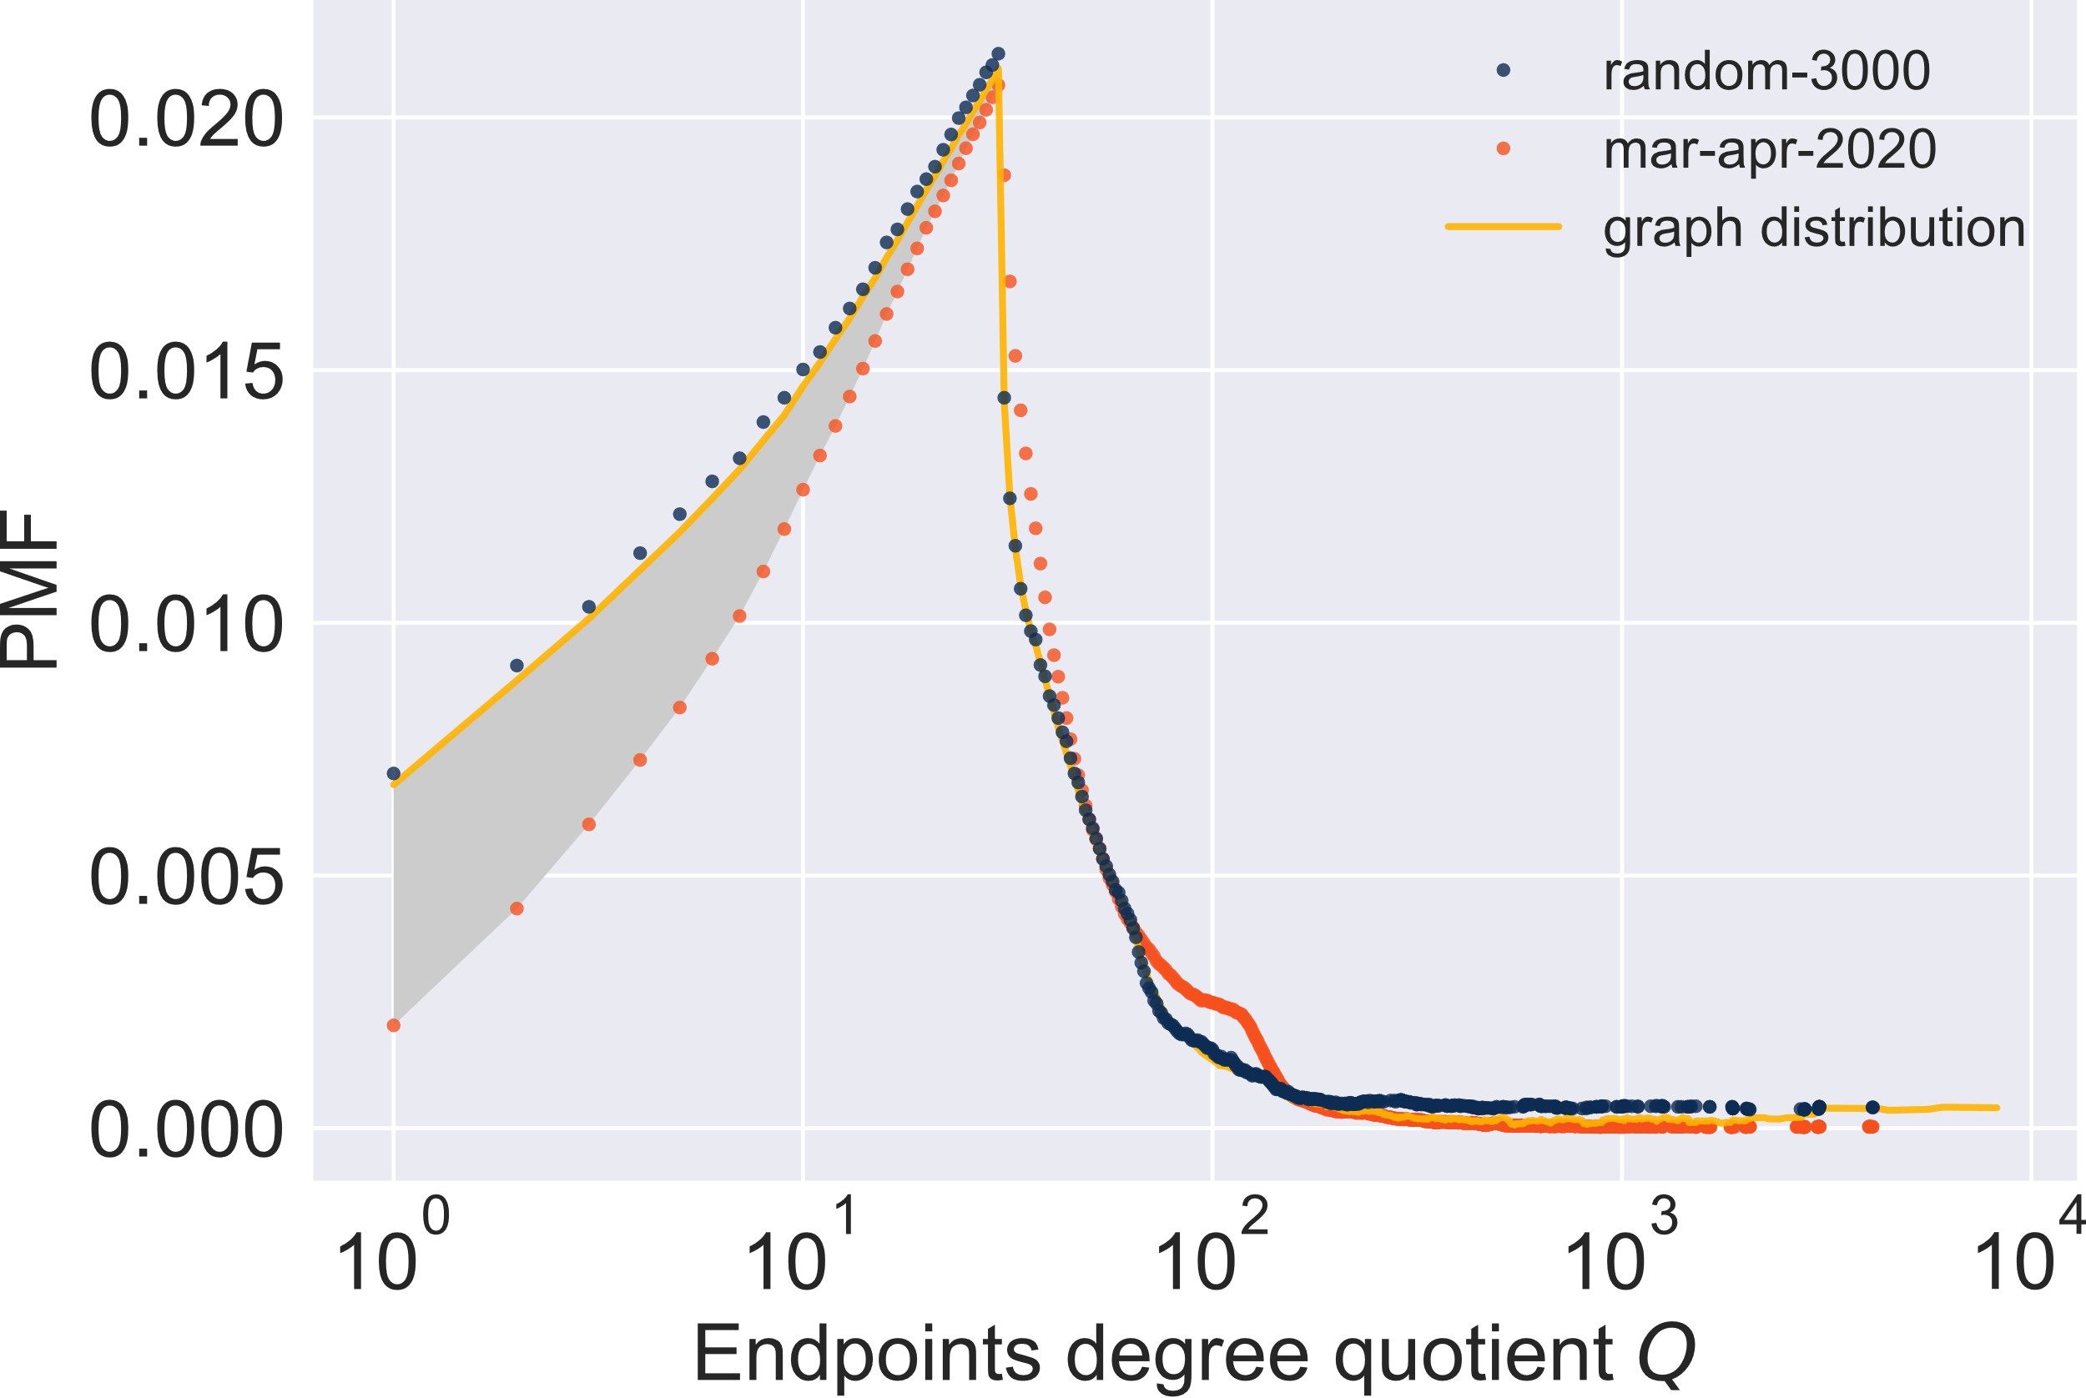
TZ for routing Real link failures
Distribution of edges
Why is stretch deterioration slower
when replaying real link failures?
The links are not
randomly distributed
NOTA BENE
In the following, I use $k=3$

Slide 31
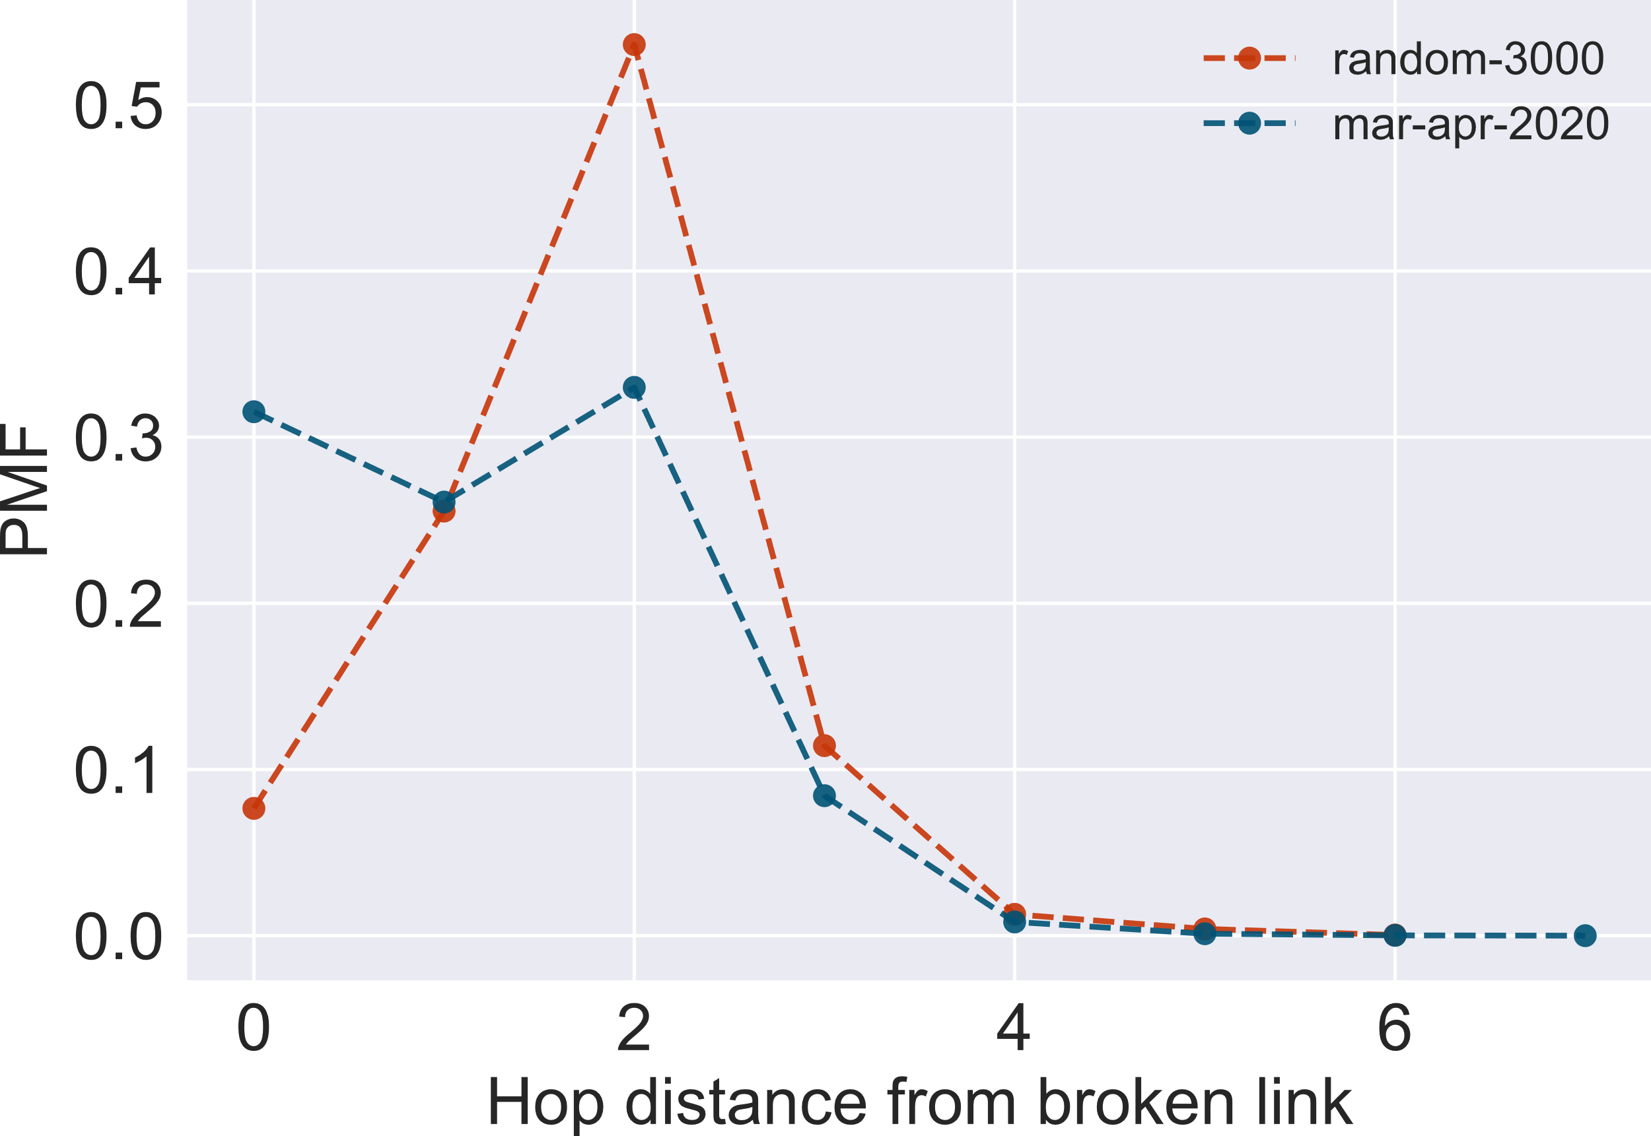
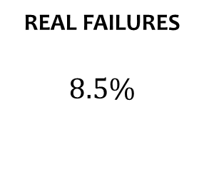
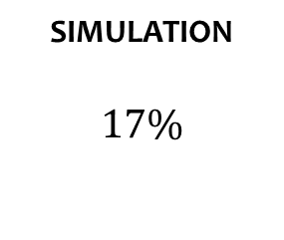
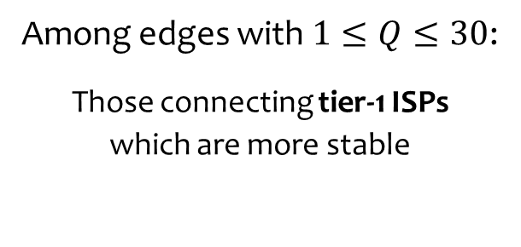
the RESULTS Stable links
Hop-distances of impacted nodes
Among edges with $1≤Q≤30$:
Those connecting tier-1 ISPs
which are more stable
Edges incident to 64 biggest^{[4]} ASes:
SIMULATION
$$17\%$$
REAL FAILURES
$$8.5\%$$
NOTA BENE
In the following, I use $k=3$

Slide 32
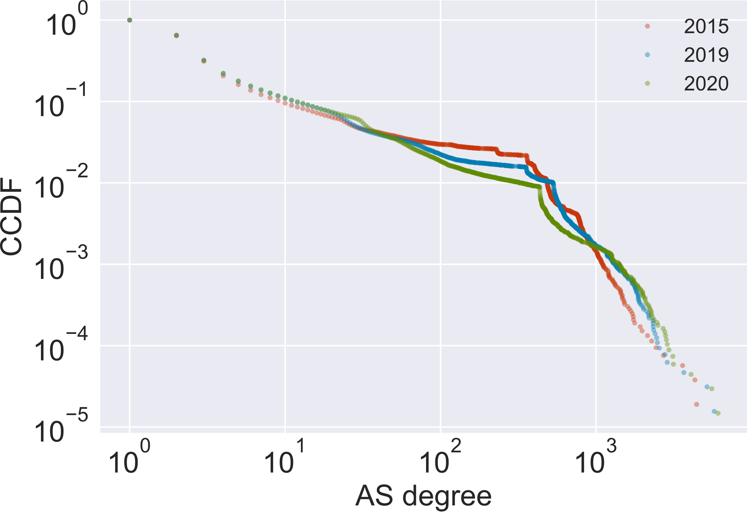
the AS graph Scale-free nature

Slide 33
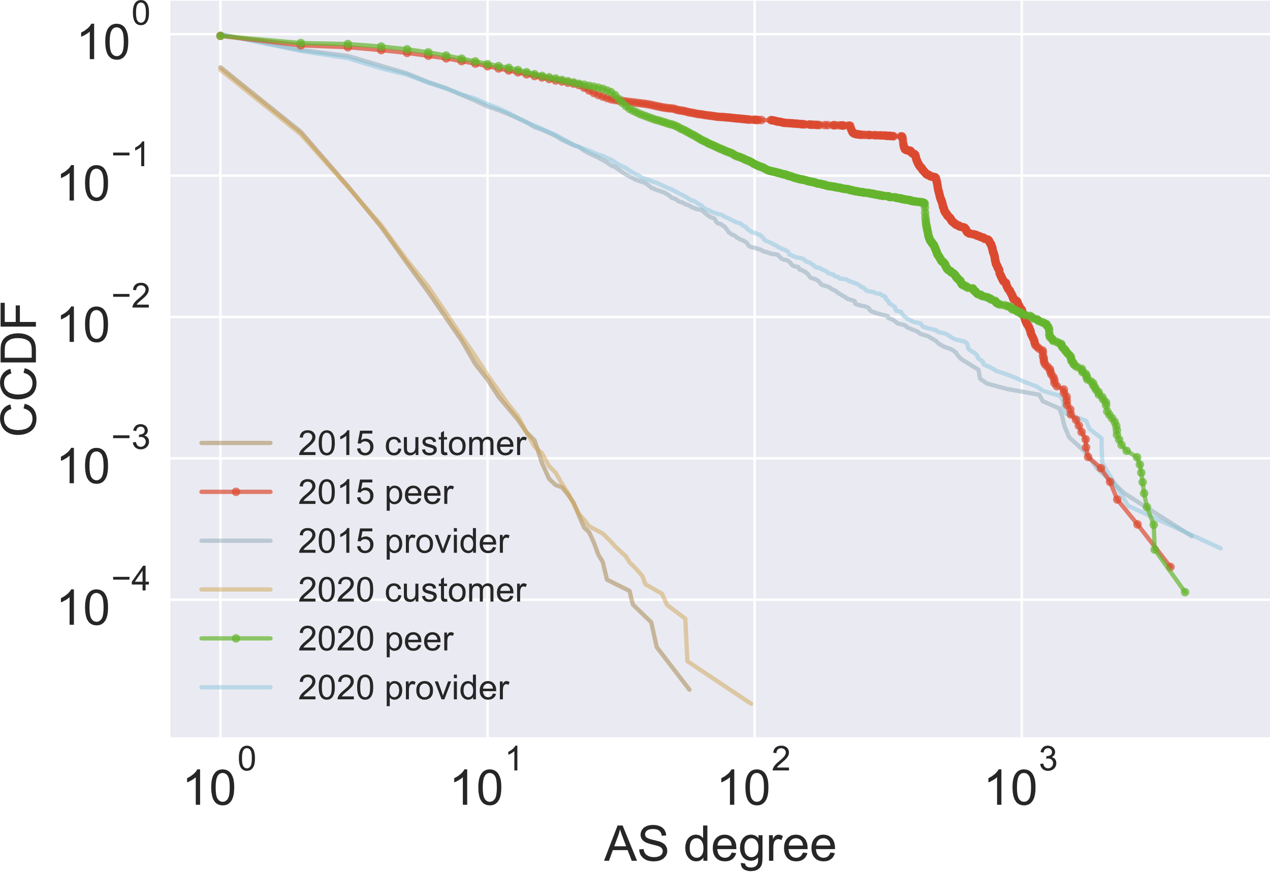
the AS graph Flattening?

